Slide 1
Array in C Programming
Md. Alamgir Hossain
Senior Lecturer,
Dept. of CSE, Prime University
Mail: alamgir.cse14.just@gmail.com

Slide 2
Array in C
An array is used to store a collection of data.
It is often more useful to think of an array as a collection of variables of the same type.
Instead of declaring individual variables, such as num0, num1, ..., and num99. you declare one array variable such as numbers and use num[0], num[1], and ..., num[99] to represent individual variables.
A specific element in an array is accessed by an index.
All arrays consist of contiguous memory locations. The lowest address corresponds to the first element and the highest address to the last element.

Slide 3
Declaring Arrays in C
type arrayName [arraySize];
Example: double salary[10], int arr[100], string myArr[100] etc
Initializing Arrays:
int arr[5] = {10, 20, 30, 40, 50};
int arr[] = {4, 5, 6, 7, 8};

Slide 4
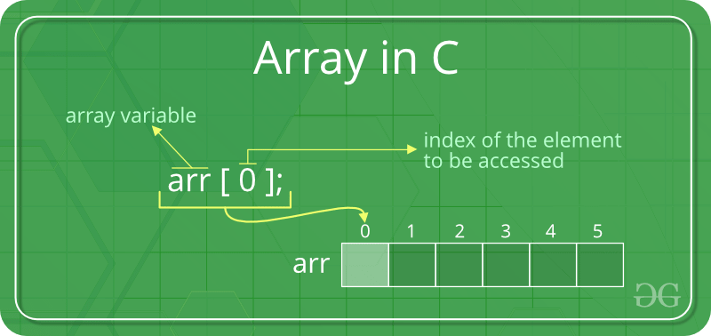
Accessing Array Elements
Array elements are accessed by using an integer index. Array index starts with 0 and goes till size of array minus 1.

Slide 5
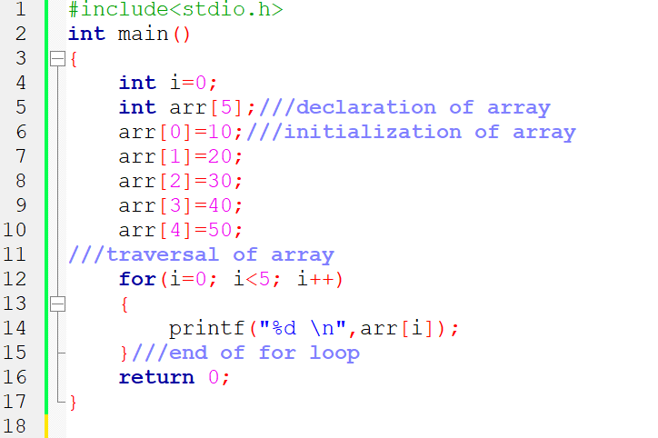
Initialization & Accessing Array Elements

Slide 6
Advantages of Array in C
Code Optimization: Less code to the access the data.
Ease of traversing: By using the for loop, we can retrieve the elements of an array easily.
Ease of sorting: To sort the elements of the array, we need a few lines of code only.
Random Access: We can access any element randomly using the array.

Slide 7
Disadvantage of C Array
Fixed Size: Whatever size, we define at the time of declaration of the array, we can’t exceed the limit.
So, it doesn’t grow the size dynamically like LinkedList which we will learn later.

Slide 8
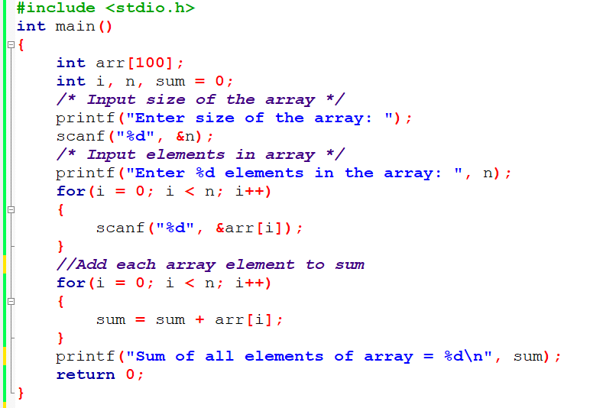
C program to find sum of array elements

Slide 9
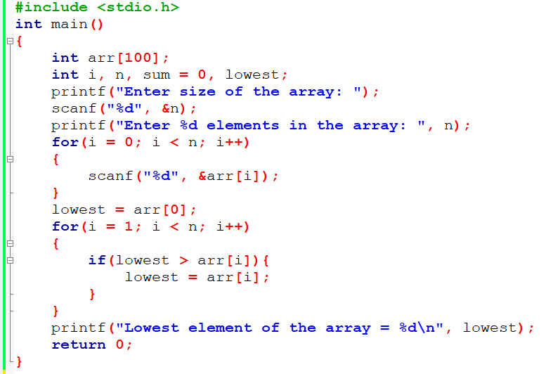
C program to find lowest number in array

Slide 10
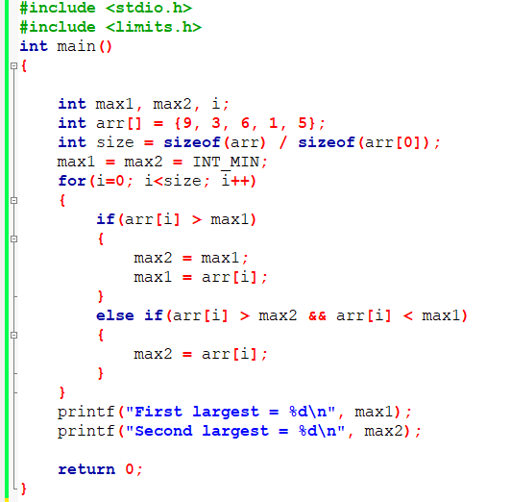
Program to find second largest element in array

Slide 11
Thank You

